Slide 1

Stocktake from 6 May in-depth discussions: Role of Cities and Regions Talanoa Dialogues
Monday, 7 May 2018, 16:45-18:15hrs CEST, UN Bonn Climate Change Conference 2018
Jisun Hwang, Senior Climate Advocacy and Policy Officer
ICLEI World Secretariat

Slide 2
Table of contents
SB48 Talanoa Dialogue
  In depth Talanoa discussions, 6 May
Talanoa Dialogue
Cities and Regions Talanoa Dialogues
  Rationale, progress
Multilevel governance for raising ambition

Slide 3
Stories of cities and regions on 6 May
Talanoa Dialogue is an opportunity to make NDCs fit for Paris Agreement.
Cities and Regions Talanoa Dialogues can help to seize the potential of urbanisation and enhancement of the engagement of local and regional governments in climate action.
Cities and Regions Talanoa Dialogues foster multilevel policy dialogue, coordination, collaboration and coherence among relevant processes and initiatives for raising the ambition of NDCs.

Slide 4
Talanoa Dialogue opening statements on 2 May
List of statements by Groups/Parties LGMA Constituency statement
Groups/Parties:
LDC Group, Environmental Integrity Group (EIG), Umbrella Group, AOSIS, European Union, Turkey, AILAC, India
LGMA Community (members, partners, allies)
NDCs fit for the PA
Create synergy with PA and NUA
Quito Cities and Regions Talanoa Dialogue on 4 May
Capturing of submissions by the LGMA community

Slide 5
Talanoa Dialogue Submissions as of 5 May
List of party Submissions and submissions from LGMA Community (members and partners)
Parties:
State of Palestine, Saint Lucia on behalf of CARICOM, China, Fiji, Norway, Saudi Arabia/Arab Group, Indonesia , Switzerland/Switzerland, Costa Rica, Finland, New Zealand and Sweden, supported by Monaco, Australia, Mexico, EU, Ethiopia, New Zealand, Egypt/African Group, Japan, Iran (Islamic Republic of)/LMDC, Egypt, Malaysia
LGMA Community (members, partners, allies)
ICLEI,C40, Global Covenant of Mayors, UNHabitat-GIZ-ICLEI, ICLEI for Cities and Regions Talanoa Dialogues , Association Climate Chance, FMDV/CCFLA, SLoCaT/PPMC, State of California, We Are Still In, Global Alliance for Buildings and Construction, US States Alliance, Nagona Prefecture, CDP, Future Ocean Alliance (supported by ICLEI and FMDV), UITP

Slide 6
LGMA Constituency Community at the Talanoa Dialogue on 6 May, as of 4 May
 | 1-Lakeba - Room No:LE-2312 | 2- Koro - Room No:LE2112 | 3- Ba - Room No: 2116 | 4- Rakiraki - Room No: 2705 | 5- Tailevu - Room No: 2309 | 6- Kadavu - Room No:1916 | 7- Bua - Rom No:2712
Q1 - Where are we? - 09:30 - 12:00 | CDP | Global Alliance for Buildings and Construction (GABC), Cities and Regions Talanoa Dialogues |  | EU Committee of the Regions |  | Under2 Coalition
Q2 - Where do we go? - 13:00 - 15:30 | Mexico City, Transport Decarbonization Alliance |  | C40 | European Economic and Social Council | Global Covenant of Mayor for Climate and Energy | California | GIZ
Q3 - How do we get there? - 16:00 - 18:30 | Global Fund for Cities Development (FMDV), WWF | Climate and Clean Air Coalition (CCAC) | Paris |  |  | ICLEI | MobiliseYourCity

Slide 7
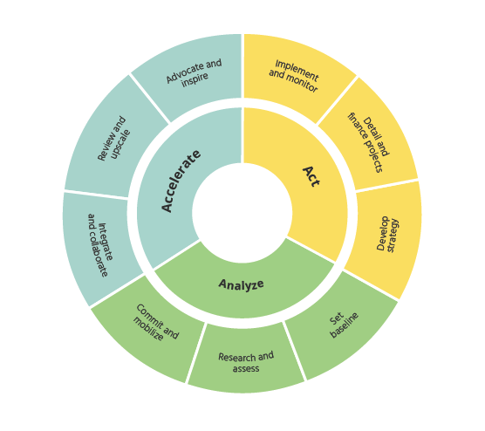


Multilevel governance
    Reporting local climate action data and exploring integrated MRV:
      carbonn Climate Registry managed by ICLEI, serving 15 initiatives, reporting from cities and regions from 87 countries
        Covenant of Mayors in Sub-Saharan Africa (CoM SSA)
          Stimulating Talanoa Dialogues in the region, esp. 11 countries
          Understanding processes and structures for vertical integration
        Urban-LEDS II project supporting 70 cities / towns in 8 countries
          Case studies and guidance on multilevel governance by GIZ, ICLEI and UN-Habitat
    ICLEI‘s support package for Local Climate Action
      tailor-made for local and regional governments in our network
        Connecting the above to NDC Partnership ICLEI, as 1st associate partner, supporting in at least 28 countries
C
C
C
C
C
C
C

Slide 8



Multilevel governance
- some key activities and initiatives
        Global Covenant of Mayors for Climate & Energy
          Finance Working Group – how to develop investor oriented Climate Action Plans, link to NDC investment plans
          Transformative Actions Program (TAP): exploring access to finance for local and regional governments, guide towards robust project concepts that are financeable (“pre-project preparation support”)
    City Climate Finance Leadership Allinace (CCFLA)
    CitiesIPCC – Global Research and Action Agenda

Slide 9
Introducing Urban-LEDS II project
Objective: Support climate action in 70 cities / towns in emerging economies & least developed countries to improve climate resilience and low emission development.
Target countries:
    Brazil, India, Indonesia, South Africa (from Phase I)
    Bangladesh, Colombia, Lao PDR, and Rwanda
    Supported by 16 European cities
Budget: 8 million Euro.
Duration: April 2017 – March 2021
Joint implementation by UN-Habitat and ICLEI

Slide 10
Urban-LEDS II project: Expected global impacts
Direct support for measuring, reporting and verification (MRV) of local climate action and encouraging integrated MRV approaches (local to national to global) on climate change adaptation and mitigation.
  GHG reduction / enhanced climate resilience
Define local contributions to Nationally Determined Contributions (NDCs), National Adaptation Plans (NAPs) and other relevant policies.
Show leadership and exchange on experiences, establish synergies with other projects and initiatives - international, regional, national and in-country (subnational).

Slide 11
Cities and Regions Talanoa Dialogues - WHY?
Paris Agreement
  All levels of governments (preamble.15)
  Common but differentiated responsibilities and respective capacities, in the light of national circumstances (preamble.3, Art. 2.2)
COP23 Decision
  Local, national, regional discussions
  Submissions
COP23 Bonn-Fiji Commitment of Local and Regional Leaders to Deliver the Paris Agreement at All Levels
  “…..We invite Parties to make use of vertical and horizontal integration to connect climate action at and across all levels of government, and to set up inclusive consultations processes domestically with their local and regional governments towards and at the 2018 Facilitative Dialogue.“ (para.II.3)
GCoM Call for Action on NDC Vertical Integration announced at the One Planet Summit

Slide 12
Cities and Regions Talanoa Dialogues - HOW?
Facilitation: ICLEI, as LGMA Focal Point and on behalf of the Global Task Force
Special Partners: UN-Habitat and the Global Covenant of Mayors for Climate and Energy
In collaboration with: UN Climate Change and Fijian COP23 Presidency
Hosts: Members, partners, initiatives of LGMA Constituency, voluntary cities and regions
Launched at the 9th World Urban Forum in Kuala Lumpur (WUF9) as a means to inform and engage broader urban community, including Ministries of Urbanization

Slide 13
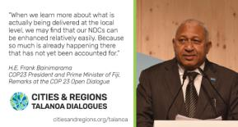
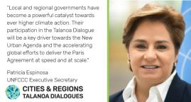
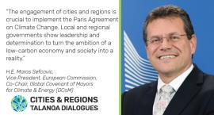
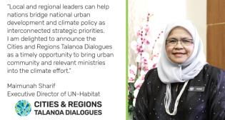
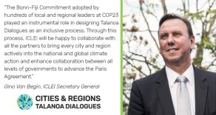
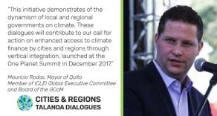

Slide 14






 | Country | City | Event/project | Host | Date
1 | Global / Malaysia | Kuala Lumpur | 9th Session of the World Urban Forum (WUF9) and launch at the High Level Roundtable | ICLEI, GCoM, UN-Habitat, WUF9 Secretariat | 9 February
2 | Regional/Europe | Brussels | Covenant of Mayors Ceremony | EU Committee of the Regions | 22 February
3 | Colombia | Medellin | UrbanLEDS-II Technical Expert Meetings | ICLEI and UN-Habitat | 26-28 February
4 | Global/Canada | Edmonton | Change for Climate - Global Mayors Summit | GCoM, FCM, City of Edmonton | 3-4 March
5 | Indonesia | Jakarta | Ambitious City Promises Project - Expert Meetings | ICLEI and SMG | 5 March
6 | Global/Canada | Edmonton | CitiesIPCC Conference - Video message of COP23 High Level Champion - Media event for Canadian Dialogues | Edmonton and CitiesIPCC Partners | 7 March
7 | Philippines | Manila | Ambitious City Promises Project - Expert Meetings | ICLEI and SMG | 7 March
8 | Viet Nam | Hanoi | Ambitious City Promises Project - Expert Meetings | ICLEI and SMG | 9 March
9 | Regional/ Europe | Brussels | European Dialogue for non state climate action | EESC, Climate Chance and CoR | 23 April
10 | Global/ Germany | Bonn | Resilient Cities Congress | ICLEI and City of Bonn | 25-28 April
11 | Ecuador | Quito | NDC Vertical Integration Call for Action | GCoM, ICLEI, C40 | 3-4 May
12 | Global/ Austria | Vienna | Austrian World Summit | R20 | 15 May
13 | Japan | Tokyo | Tokyo Forum for Clean City and Clear Sky | Tokyo Metropolitan Government | 21-23 May
14 | Global/ Sweden | Malmö | Clean Energy Ministerial | City of Malmö, GCoM, ICLEI | 23-25 May
15 | Global/ France | Strasbourg | UCLG Executive Bureau | UCLG, Strasbourg, Climate Chance | 23-24 May
16 | Canada | Montreal | ICLEI World Congress - Media event in Edmonton | ICLEI, FCM and Montreal | 19-22 June
17 | Norway | Drammen | Dialogue of Minister of Climate and Environment and city/regional governments | Ministry of Climate and Environment and Norwegian Association of Local and Regional Authorities (KS) | 11 June
18 | Regional/Africa/ Cote d'Ivoire | Abidjan | Climate Chance - Africa 2018 | Climate Chance Association and ARDCI | 28-29 June
19 | Global/ Regional/ Morocco | Chefchaouen | 1st World Forum of Intermediary Cities | UCLG | 5-7 July
20 | Regional / Republic of Korea | Seoul | North East Asia Air Quality Forum | ICLEI and Seoul Metropolitan Government | 4-5 September
21 | USA | San Francisco | Global Climate Action Summit | State of California | 12-14 September
22 | Global/Regional/Spain | Barcelona | International Climate Alliance Conference | Climate Alliance | 1-3 October
23 | Mexico | Campeche | Conferencia Internacional | SEMARNATCAM, nrg4sd and others | 25-26 October
24 | Global/ Argentina | Buenos Aires | U20 Summit | Buenos Aires, Paris and C40 | 29-30 October
Facilitated by:
On behalf of:
Special partners:
In collaboration with:

Slide 15
Cities and Regions Talanoa Dialogues - HOW?
COP23 Presidency Guidance Question | Focus | Relevance for local and regional governments | ICLEI Formulated question? | Specific issues
Where are we? | DELIVERY Plans and Actions under the current NDC | Is sustainable urbanization adequately included in the current NDCs? | How can local and regional governments help national governments (including ministries of climate change and urbanization) to seize the potential of sustainable and integrated urban and territorial development in the of implementation of NDCs? | Does the current NDC refer to national urban policy or does it have any specific references to urban sectors like buildings, transport, waster, demand-side energy efficiency, renewable energy, sustainable consumption or production, procurement, biodiversity (e.g: reality check with NDCs and UN-Habitat Analysis) If yes, are these consulted with the respective local and regional governments If not, is there any room to integrate existing plans, actions or commitments of local and regional governments into the current NDCs (e.g. captured at carbonn Climate Registry or GCoM Commitment), as well as those developed by other ministries of urbanization
Where do we want to go? | RAISE Ambitions of current and future NDCs | How can we raise national ambition through multilevel governance | What are the options to integrate commitments and actions of local and regional governments in to current and future NDCs | 1) How can national commitments integrate existing and future commitments (e.g. captured at carbonn Climate Registry or GCoM Commitment) of local and regional governments into current and future NDCs?
How do we get there? | DEVELOP Road ahead | What measures and changes are needed? | How can national governments collaborate with local and regional governments to mobilize appropriate technical, financial and policy resources to realize solutions addressed in delivering and raising ambition | Roadmaps for Towards 2018 Towards 2020 Beyond 2020

Slide 16

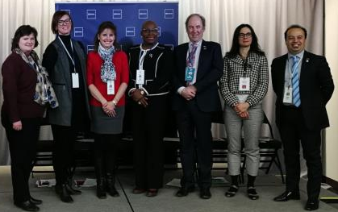

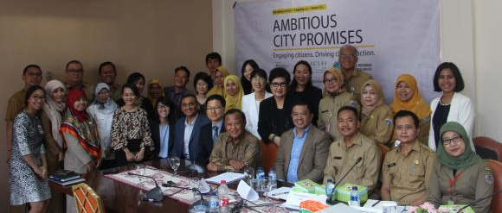

Minister of St.Lucia
Councilor of Edmonton, Chair of FCM GMF
Environment Secretary of Quito and Montreal
ICLEI
Office of the President's Special Envoy for Climate Change
Ministry of Environment and Forestry
Ministry of National Development Planning (BAPPENAS)
Provincial Development Planning Agency
Resilient Jakarta Secretariat
Cities: Jakarta / Bekasi / Tangerang / Seoul
WWF Indonesia
ICLEI

Slide 17
Cities and Regions Talanoa Dialogues - WHAT?
Respective NDCs – http://www4.unfccc.int/ndcregistry/Pages/Home.aspx
UN-Habitat Analysis – https://unhabitat.org/books/sustainable-urbanization-in-the-paris-agreement/
carbonn Climate Registry data – www.carbonn.org
GCoM Committed Cities – https://www.globalcovenantofmayors.org/
CitiesIPCC conference outcomes – https://citiesipcc.org/
Talanoa Dialogues Homepage: https://talanoadialogues.com
Cities and Regions Updates www.citiesandregions.org/talanoa

Slide 18
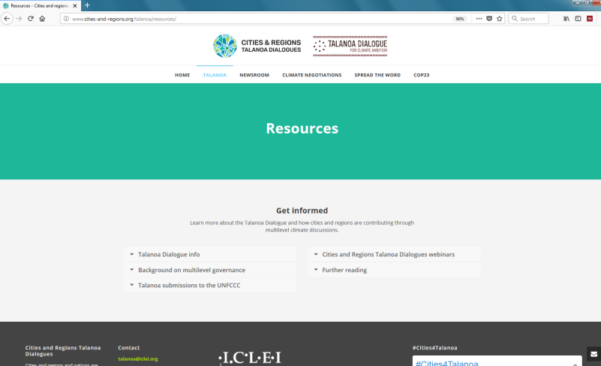
Resources page with Submissions of the LGMA community to the UNFCCC

Slide 19
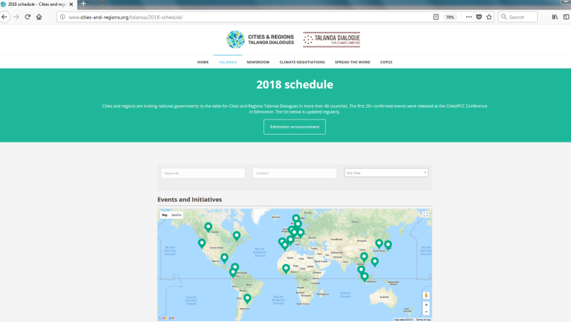
2018 schedules of the Cities and Regions Talanoa Dialogues
Each of the CRTD events has its separate page (can be accessed through a click on the event).

